Slide 1
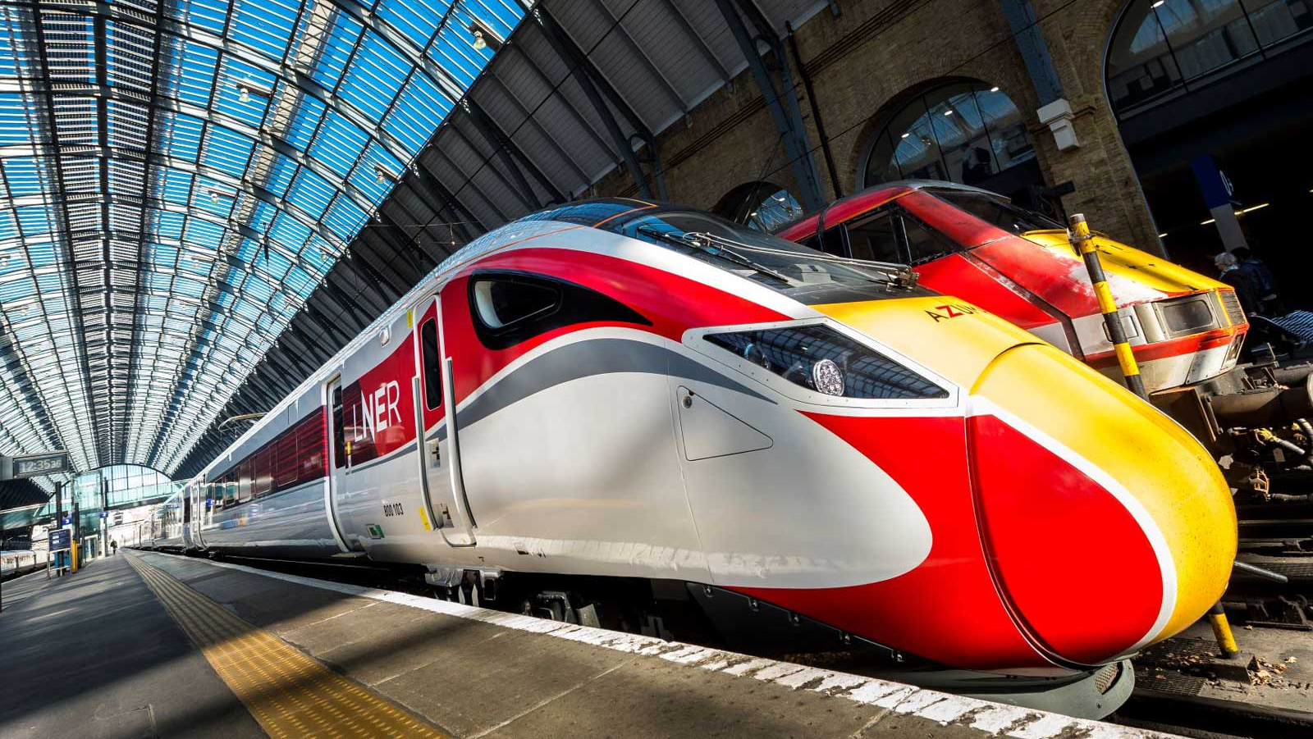

Railway Data Analysis
Data Analytics Project

Slide 2
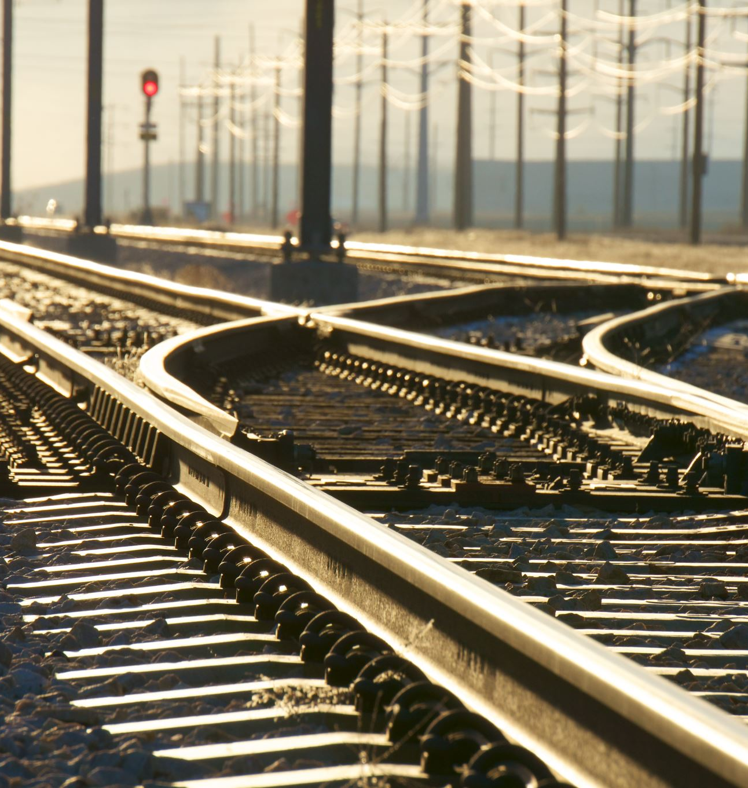

Content
1. Overview of Railway Project
2. Railway Project Data Analysis
3. Insights and Decision-Making

Slide 3


Section : A
Overview of Railway Data

Slide 4

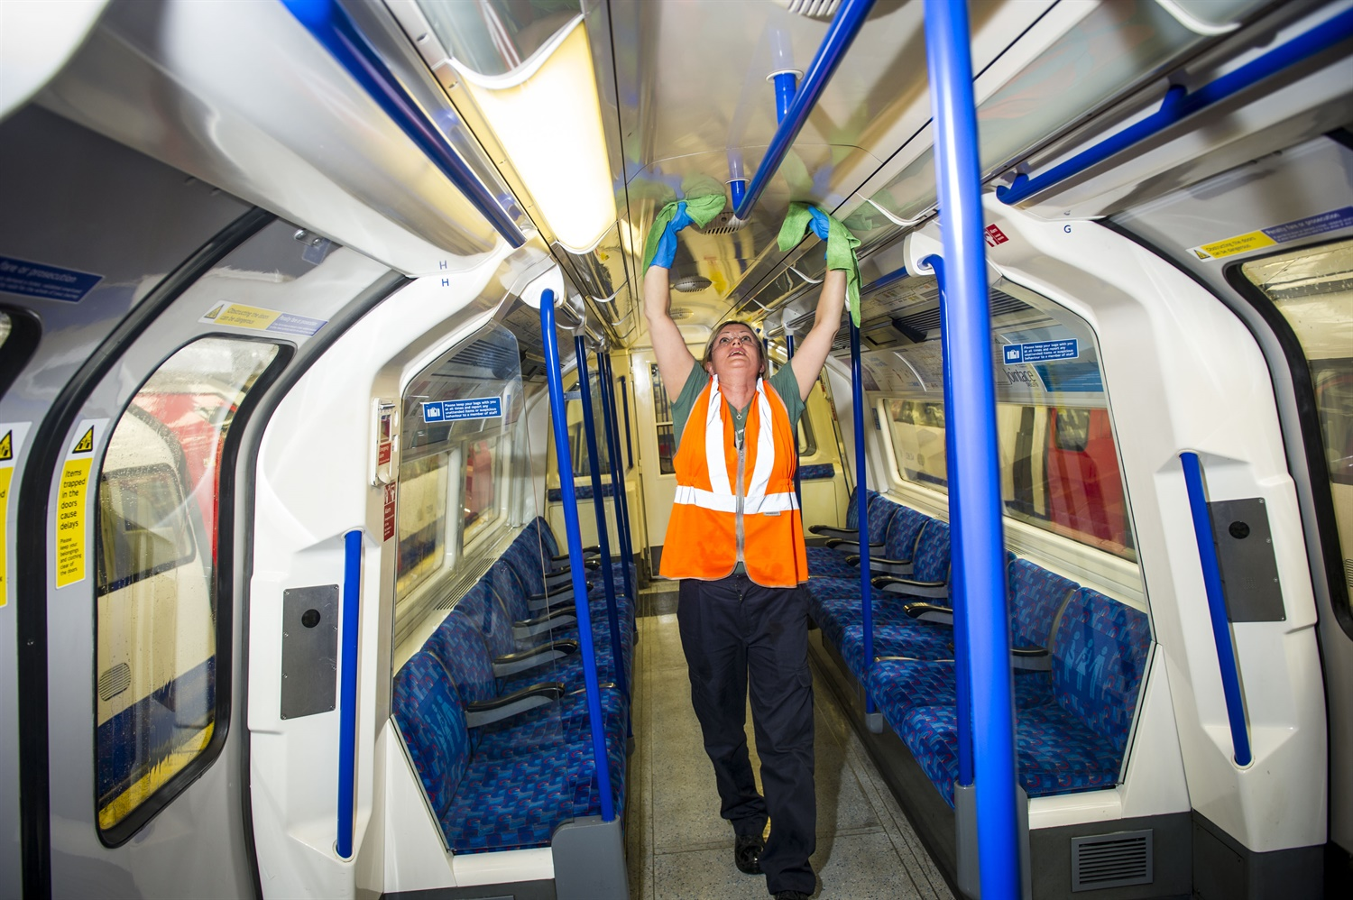
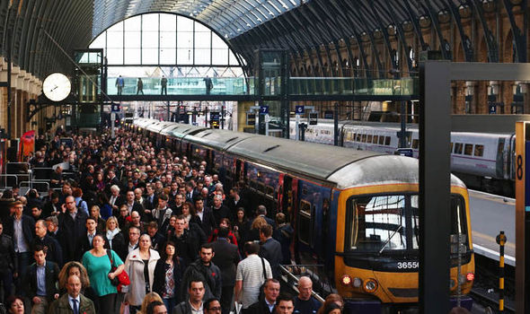

Importance of Railway Project
Operational Significance
Public Impact
Data Richness
Railways collect enormous
amounts of data about the
current customer details ,
providing a comprehensive
view of operations and
performance.
The analysis of railway data
offers insights into efficiency,
reliability, safety and punctuality,
Which are crucial for optimizing
railway operations.
Railway data analysis directly impacts
the public by ensuring improved service
quality.

Slide 5
Challenges in Data Preparation
Data Format Issues
Data Quality and Integrity
Impact
Delays in analysis due to data preparation challenges.
Potential for errors in analysis if data issues are not addressed.
Data received in various formats.
Time-consuming data cleaning and transformation processes.
Ensuring data accuracy, consistency, and reliability.
Importance of high-quality data for meaningful analysis and decision-making.

Slide 6

Section : B
Railway Data Analysis

Slide 7


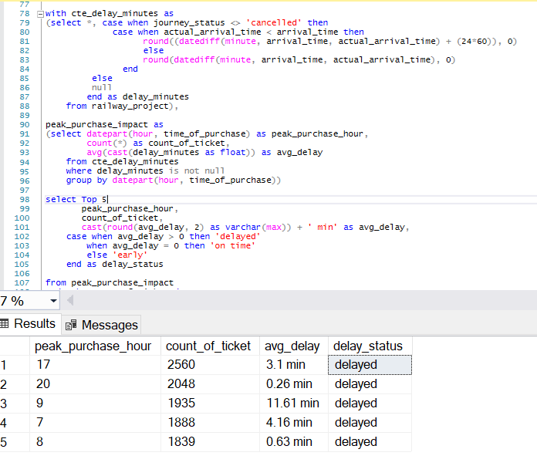
Peak Times and Delay Impact
Peak Times:
Morning Peak: 6-9 AM
Commuters heading to work
Evening Peak: 5-8 PM
Commuters returning home
Correlation with Delays:
Morning peak (9 AM) and evening peak (6 PM)
Average delays range from 23 seconds to 11.61 minutes
Additional Delays:
Late morning (10 AM to 12 PM)
Operational Assumptions:
High passenger volumes and operational constraints cause delays

Slide 8

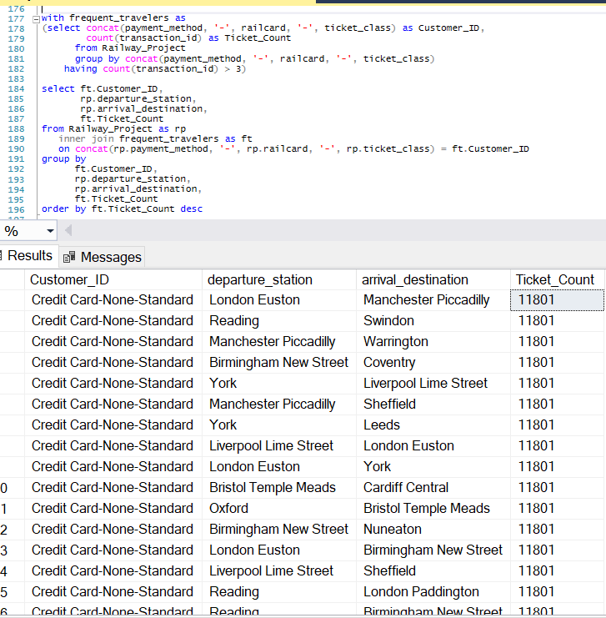

Journey Patterns of Frequent Travelers
Frequent Travelers By Traveler Profile:
Preference for economical journeys
High use of credit cards and contactless payments
Majority without railcards
Frequent Travelers By Popular Routes:
Manchester Piccadilly to London Euston
Liverpool Lime Street to Manchester
Routes involving Birmingham New Street
Frequent Travelers By Payment Methods:
Dominance of credit cards
Followed by contactless payments

Slide 9


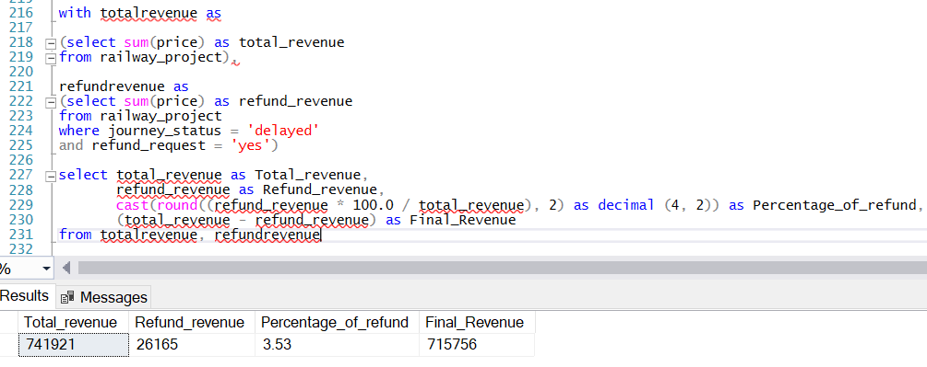
Revenue Impact of Delays and Refunds
Revenue Loss Due to Delays
Total Revenue: 741,921 from ticket sales
Refunds Due to Delays: 26,165
(3.53% of total revenue)
Net Revenue: 715,756
Impact: Significant revenue loss due to delays

Slide 10


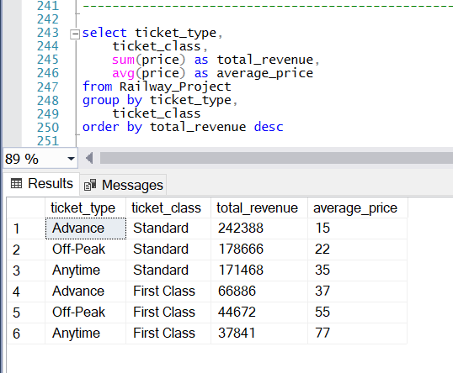


Revenue & Average Ticket Price By Ticket Type & Class
Off-Peak Tickets
Standard Class:
Total Revenue: 178,666
Average Ticket Price: 22
First Class:
Total Revenue: 44,672
Average Ticket Price: 55
Advance Tickets
Standard Class:
Total Revenue: 242,388
Average Ticket Price: 15
First Class:
Total Revenue: 66,886
Average Ticket Price: 37
Anytime Tickets
Standard Class:
Total Revenue: 171,468
Average Ticket Price: 35
First Class:
Total Revenue: 37,841
Average Ticket Price: 77

Slide 11

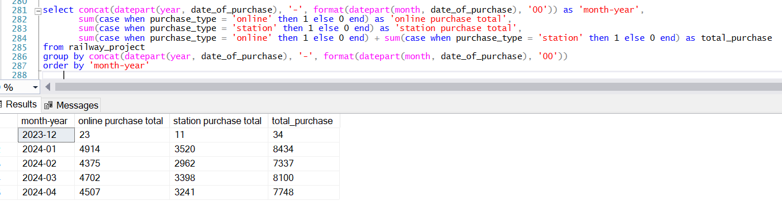

Ticket Purchase Trends
Online Purchases:
Consistently higher than station purchases
Peak in January 2024 with 4914 purchases
Station Purchases:
Lower than online purchases across all months
Peak in January 2024 with 3520 purchases

Slide 12

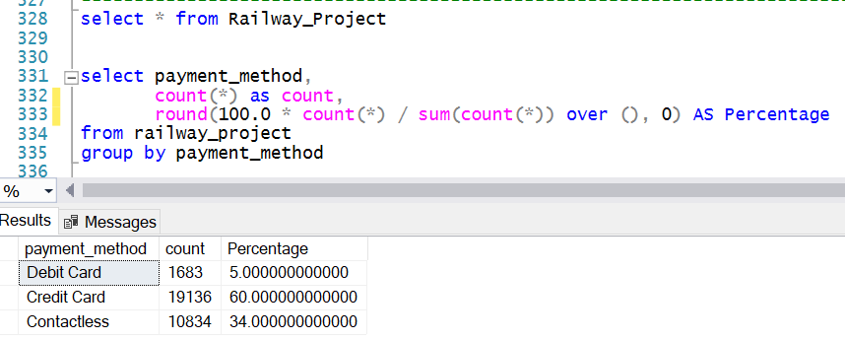

Payment Method Trends
Payment Mode : Credit Card
Total Transaction : 19,136
Percentage of Total : 60%
Dominant
Payment Mode : Contactless
Total Transaction : 10,834
Percentage of Total : 34%
Second
Most Used
Payment Mode : Debit Card
Total Transaction : 1,683
Percentage of Total: 5%
Least Used

Slide 13


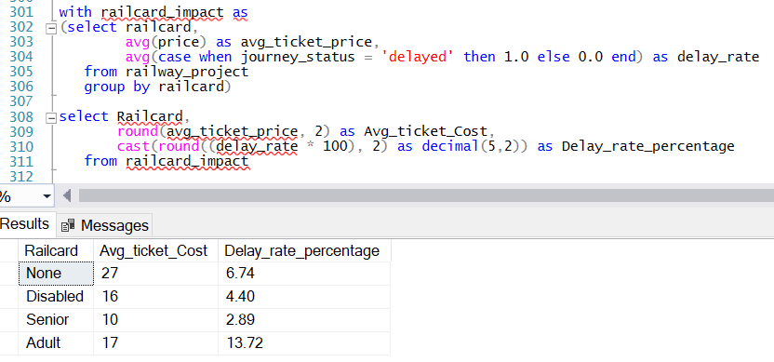



Impact of Railcards on Ticket Prices and Journey Delays
Senior Railcards:
Lower ticket prices (Cost-10)
Moderate delay percentage (2.89%)
Disabled and Senior Railcards:
Lower ticket costs (Cost-16)
Lower delay rates (4.40%)
None Railcards:
Highest ticket prices (Cost-27)
Moderate delay percentage (6.74%)
Adult Railcards:
Moderate ticket prices (Cost – 17)
Higher delay rates (13.72%)

Slide 14

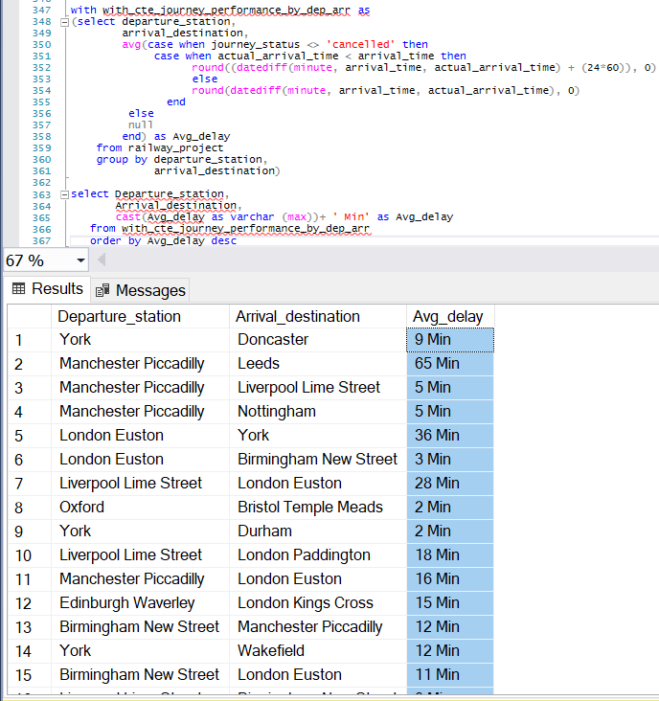
Journey Performance by Departure and Arrival Stations:
High Delays Routes :
Manchester Piccadilly to Leeds (65 minutes)
London Euston to York (36 minutes)
Liverpool Lime Street to London Euston (28 minutes)
Moderate Delays Routes :
Edinburgh Waverley to London Kings Cross (15 minutes)
Manchester Piccadilly to London Euston (16 minutes)
Low Delays Routes :
London Euston to Birmingham New Street (3 minutes)
York to Durham (2 minutes)
Oxford to Bristol Temple Meads (2 minutes)

Slide 15

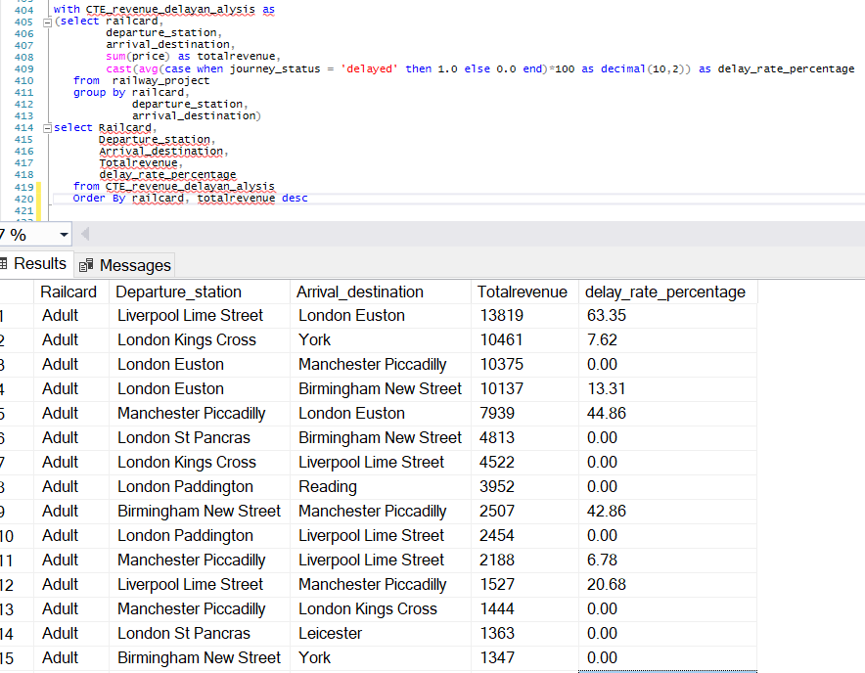
Revenue and Delay Analysis by Railcard and Station
Disabled Railcard:
High Revenue Routes:
London Euston to Manchester Piccadilly (Revenue: 12,505 with 8.21% delay)
London Kings Cross to Edinburgh Waverley (Revenue: 11,205 with 5.79% delay)
Route with High Delay: York to Wakefield (100% delay rate)
Senior Railcard:
High Revenue Route:
London St Pancras to Leicester (Revenue: 9,345 with no delays)
Routes with Significant Delays:
Oxford to Bristol Temple Meads (100% delay)
Liverpool Lime Street to London Euston (100% delay)
Adult Railcard:
High Revenue Routes:
Liverpool Lime Street to London Euston (Revenue: 13,819 with 63.35% delay)
London Euston to Birmingham New Street (Revenue: 10,137 with 13.31% delay)
London Kings Cross to York (Revenue: 10,461 with 7.62% delay)
None Railcard:
High Revenue Routes:
London Kings Cross to York (Revenue: 14,210 with 6.94% delay)Liverpool Lime Street to London Euston (Revenue: 12,904 with 12.18% delay)
Routes with Severe Delays:
London Euston to York (18.72% delay)
Manchester Piccadilly to London Euston (20.91% delay)

Slide 16

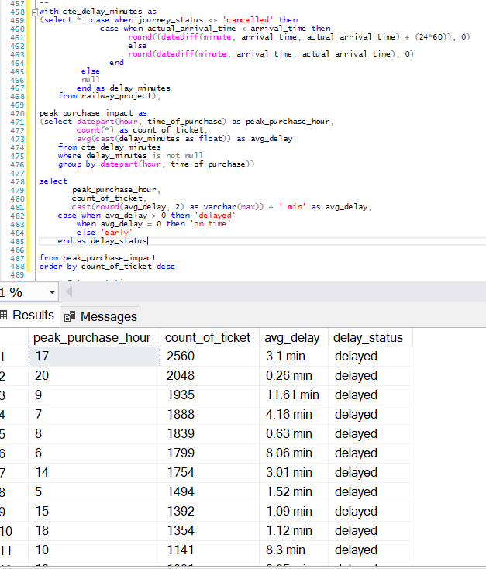
Journey Delay Impact by Hour Of Day
Peak Purchase Hours:
5 PM (2560 tickets)
8 PM (2048 tickets)
Average Delay Duration:
Highest at 9:00 AM (11.61 minutes)
Significant at 6:00 AM (8.06 minutes), 10:00 AM (8.3 minutes), 12:00 PM (6.68 minutes)
Lowest at 4:00 AM (0.23 minutes)
Delay & Non-Delay Status:
Most hours experience delays, exceptions at 9 PM, 10 PM, 11 PM

Slide 17

Section : C
Insights and Decision-Making

Slide 18
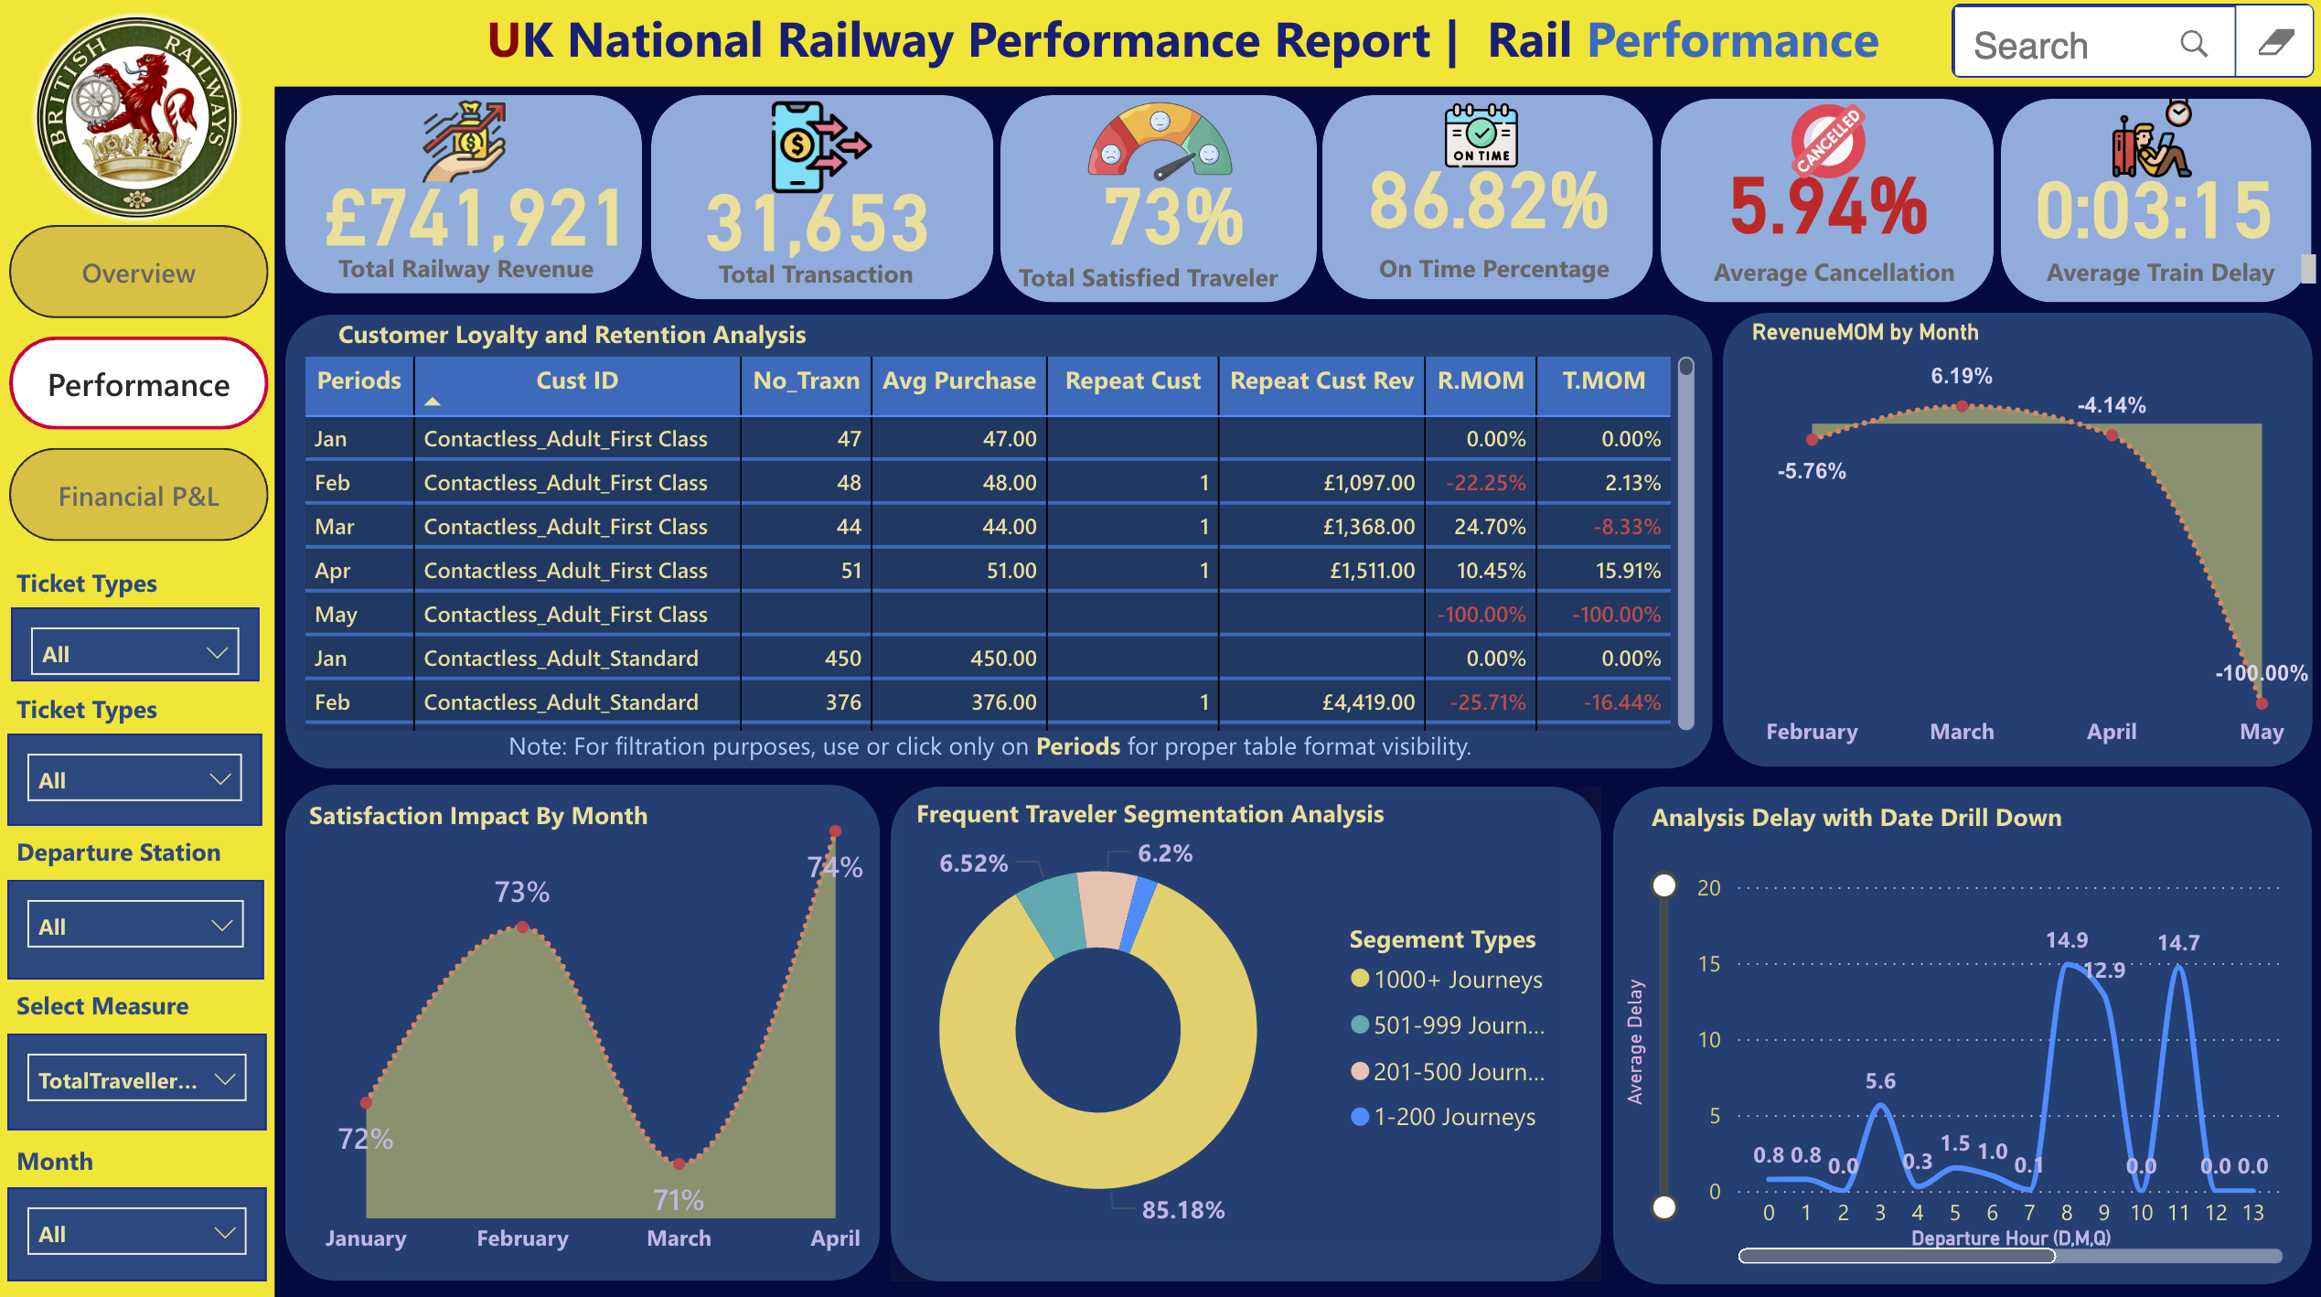
Insights and Decision-Making 1.0.0
Live Power BI

Slide 19
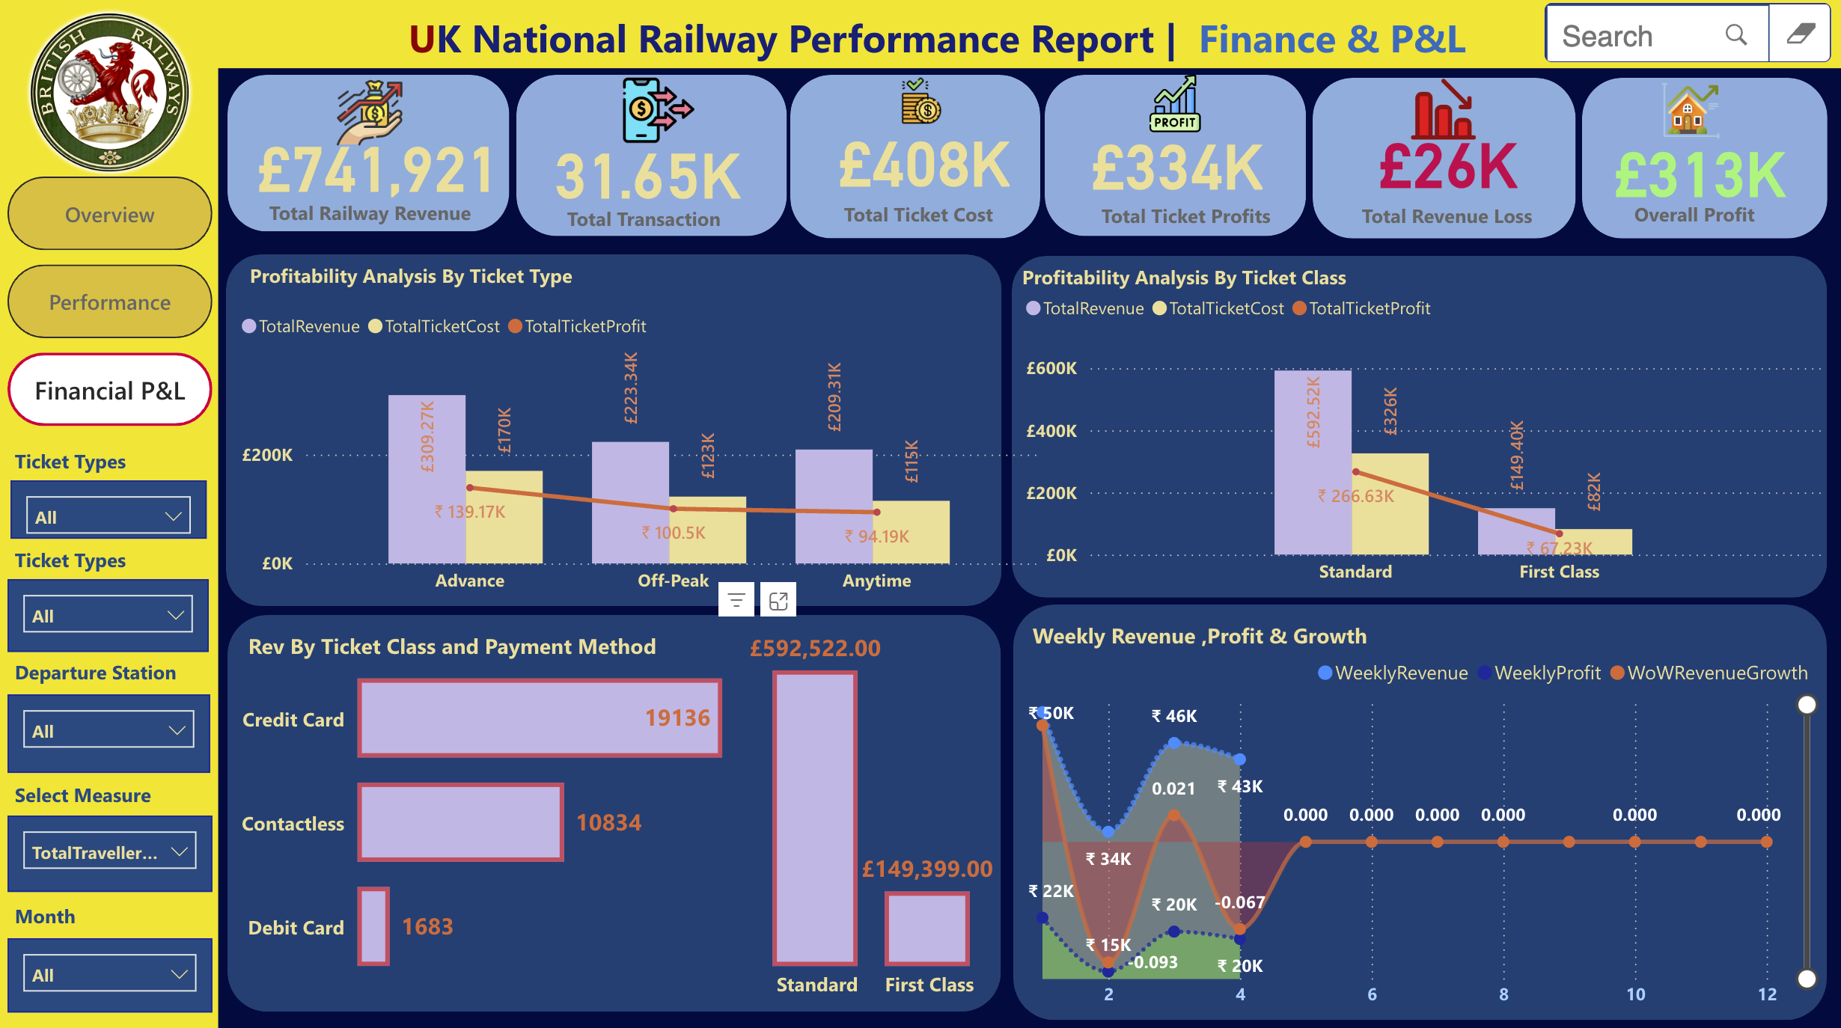
Insights and Decision-Making 1.0.1
Live Power BI

Slide 20

Insights and Decision-Making 1.0.2
Optimize Peak Hour Services:
Increase train frequency and improve dispatch coordination during peak hours to reduce delays and maintain on time performance on non peak hour.
Tailor Services for Railcard Holders:
Maintain fare structure for Disabled and Senior railcard holders and explore compensations for Adult railcard holders.
Enhance Popular Routes: / (FTR)
Improve service quality on frequently travelled routes and offer loyalty programs for frequent travellers & optimize services for Adult Railcard holders who experience high delays despite holding railcars.
Reduce Revenue Loss Due to Delayed, Tech & Staffing Issue: (Loss: 38,702 - 5.22 %)
Improve punctuality to minimize refund requests and maintain customer satisfaction.
Resolve staffing issues to ensure optimal operational capacity and service delivery.
Address operational inefficiencies to enhance overall service reliability and customer experience.
Prioritize Routes with Massive Delays:
Focus on resolving operational and staffing issues on routes with significant delays, such as Manchester Piccadilly to Leeds.
Implement targeted strategies to enhance punctuality and service reliability on these critical routes, preventing travelers from diverting to other modes of travel.
Rev: 741,921 D Ref: 26k + (3.53%) D & S & T Ref: 38,702 (5.22%)

Slide 21


